Slide 1
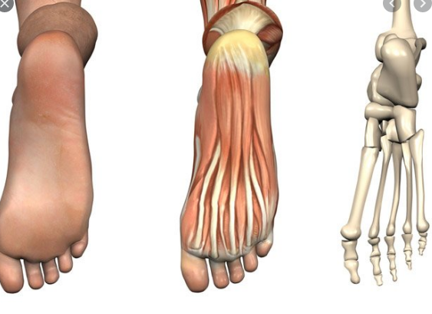
PODIATRY SERVICES DIGITAL MARKETING STRATEGY
Student’s Name
Institution of Affiliation
Date

Slide 2
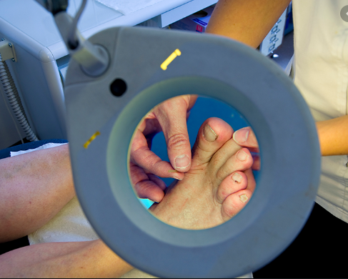
Presentation Scope
Introduction
Organization’s mission and vision
Target market
Customers for Podiatric services
Market Segmentation
Digital Media that will be used
Digital marketing strategy
Review of organization Website

Slide 3

Introduction
Podiatry can be described as a medical specialty that deals with treatment of lower limbs and foot related problems or conditions. Podiatric services and treatment are provided by podiatrists. Treatment for lower limbs and foot conditions range from general foot care to non-invasive shoe inserts. Specialized services include long term care for foot problems for instance preventive diabetic foot care and recovery after undergoing surgical procedures.
Notes:
Podiatry is a medical specialty that deal with diagnosis and treatment of feet and lower limb problems. Podiatrists treat feet and lower limb conditions that are often caused by medical condition such as arthritis, diabetes and heart disease. Treatment for these conditions range from non invasive shoe inserts to general foot care such as podiatric surgery to correct complication. Specialized podiatric services include providing preventive diabetic footcare and rehabilitation from surgical procedures.

Slide 4

The Organization’s Mission and Vision
Wake Forest Baptist Health is a healthcare facility focused on providing quality care to achieve optimal patient health outcome and improve population health.
Mission
The organization’s mission is to enhance the health of the region and nation by;
Providing quality healthcare services to attain the best possible health outcomes.
Creating and transferring knowledge for prevention, diagnosis and treatment of diseases.
Vision
The organization’s vision is to promote better health through collaboration and innovation.
Notes:
Wake Forest Baptist Health is committed to providing personal care that meets patient’s needs. The organization’s mission is to enhance the health of the region, state and the nation by providing quality healthcare services that can help achieve optimal patient health outcomes, creating and transferring knowledge for prevention, diagnosis and treatment of various diseases. Its mission is to promote better health through collaboration, excellence and innovation.

Slide 5
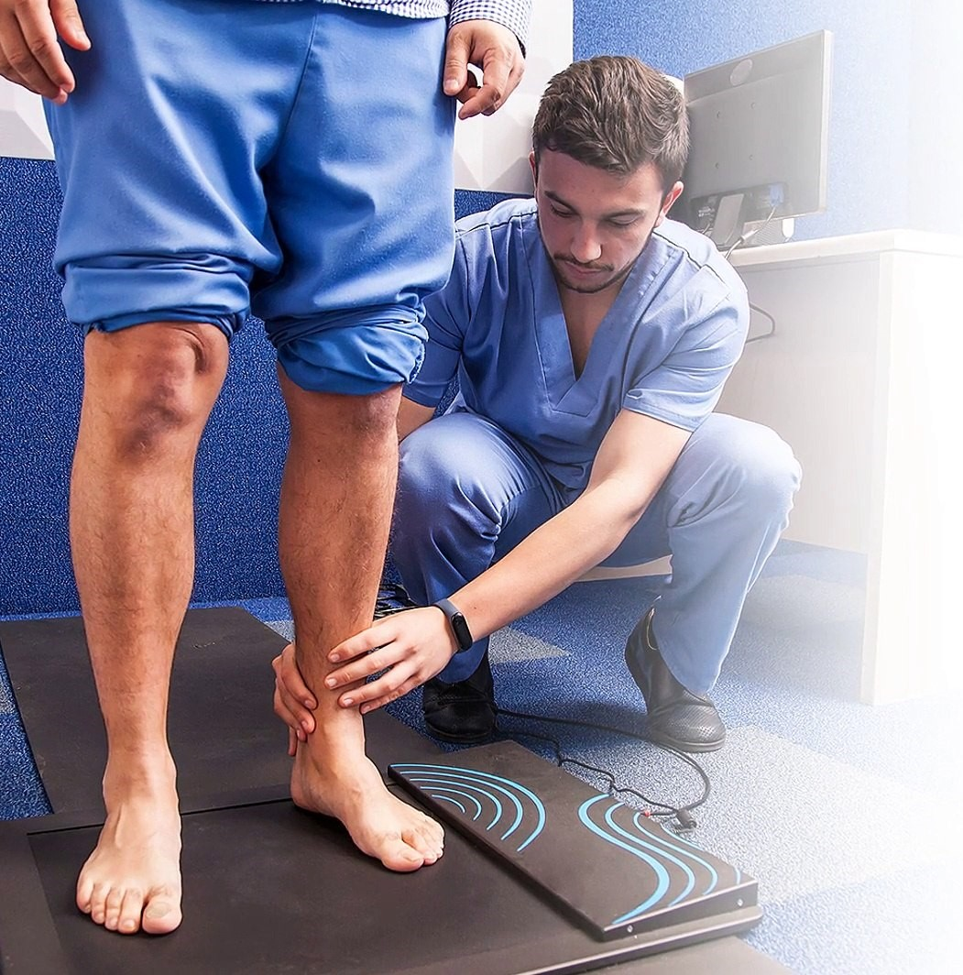
Benefits of Podiatry
Podiatrists are medically trained and qualified to diagnose and treat conditions affecting feet and lower limbs. Feet are important parts of a human being especially in facilitating mobility therefore it important to take care of them (Wylie et al., 2019).
  Podiatry allows professionals to take a specialized approach to diagnosis and treatment of feet and lower limbs conditions.
  Helps prevent future feet and lower limb problems.
  Foot wear recommendations
  Extensive knowledge on the make up of lower limbs and feet.
Notes:
Our feet take a lot of pressure and stress supporting our body weight. Whereas they are a remarkable piece of engineering, they often develop complication. It is critical to take care of them as they are important parts of our body especially in facilitating our mobility. Podiatrists play an important role in diagnosis and treatment of foot problems and preventing future problems from developing. The Wake Forest Baptist Health believes that the benefits of podiatry go beyond healing foot problems. A person’s well-being is improved if ankle and foot problems are solved.

Slide 6

Why Choose Wake Forest Baptist Health
Wake Forest Baptist Health podiatrists understand internal and eternal makeup of feet and lower limbs therefore, provide specialize treatment. Patients should seek podiatric services from Wake Forest Baptist Health as:
  Offers customized foot care solutions
  Provide specialized care with latest technologies
  Provides Medicare approved podiatry services.
Notes:
Wake Forest Baptist Health is devoted to providing personal care that meets patient’s needs. Our specialists are trained to provide quality ankle and foot injury treatment services for sprains and fractures. Additionally, we provide treatment services for ruptured Achilles tendon as well as other condition such as bunions, ingrown toenails and fungal infections. Our team is certified by the American Board of Podiatric Surgery. The organization proves customized foot care solutions, provides specialized care with latest technologies.

Slide 7

Target Market
The target market for podiatric services are individual experiencing lower limb and foot problems. An average person is makes approximately 1000 steps in a day. That is 100000 miles in a lifetime and each step that a person takes put the entire body’s weight on the feet. In the long run, these causes wear and tear of the ankle and foot bones. We rely on our feet and ankles for movement, thus, having problems or conditions affecting these areas slows you down or impedes your movement. Arches, Achilles tendons, corns, ingrown toenails and bunions can make waling or running painful therefore slowing you down. Additionally, medical conditions such as arthritis, diabetes and heart disease signs can be recognized in the feet therefore making it podiatric services important.
Notes:
The target the market for pediatric services are individuals experiencing ankle and foot problems. Middle and old age adults are often the most affected by these conditions, however children and young people are also affected. It is estimates that an average person makes up to 1000 steps in a day, each single step puts pressure and stress on the feet, therefore it easier to see why feet problems develop. It is therefore crucial to address these problems for better health and well being.

Slide 8

Customers For Podiatric Services
Podiatric services are marketed to middle and old age populations. Aging takes a toll on a person’s feet just as the rest of the body. Considering the amount of pressure and weight that people put their on their feet in their lifetime, it is easy to determine why these problems occurs as a person ages. In addition to the wear and tear that occurs due to aging, physiological changes also affect how bones, joints and tendons function. These physiological changes develop gradually as collagen production and cell turnover slows. This pediatric services are therefore market to middle age and old age people who are more affected by lower limb and feet problems.
Notes:
Podiatric services are marketed to middle and old age populations. Aging takes a toll on a person’s feet just as the rest of the body. Considering the amount of pressure and weight that people put their on their feet in their lifetime, it is easy to determine why these problems occurs as a person ages. . In addition to the wear and tear that occurs due to aging, physiological changes also affect how bones, joints and tendons function. These physiological changes develop gradually as collagen production and cell turnover slows.

Slide 9
Market Segmentation
Market segmentation is described as a process of dividing diverse market into more comparable segments based on various parameters (Gunawardane, 2020). Podiatric market will be segmented into;
Podiatric Surgery
Involves surgical treatment of conditions affecting ankle and lower extremities.
Podopaediatric
Focusses on treatment of young children.
Sports Medicine
This entails detailed assessment, examination, diagnosis and treatment of sport injuries of feet and lower limbs
General Podiatry
General podiatry involves general foot treatment practices such as nail cutting, corn, hard/dry skin removal and filling.
Notes:
Market specialization entails the process of dividing the heterogenous market into a homogenous segments. Segmentation of podiatry market is based on specialization, treatment condition, facility and geography. The specialization type is divided into general podiatric surgery, general podiatry, sports medicine and podopediatrics. Treatment conditions are divided into comorbid and non-comobid conditions.

Slide 10

Digital Media
A digital marketing strategy is a plan outlining how an organization will attain in marketing goals through the use of digital platforms such as social media. In the modern world where many people use digital devices and spend most of their time online, digital marketing is important. Digital media is one of the best ways to market and grow your organization. Digital transformation has changed the healthcare industry. Patients now have variety of options to seek care and monitor their health on online platforms. For Wake Forest Baptist Health its path to success is based on implementing digital marketing strategies and creating a strong online presence to get patients who are online. The digital marketing that will be used to market the organization’s services include;
1. Search engine optimization 3. Email marketing
2. Search engine marketing 4. Social media platforms such as Facebook and twitter.
Notes:
In a world that is increasingly becoming technologically oriented online marketing is critical for organization growth and success. . Digital media is one of the best ways to market and grow your organization. Digital transformation has changed the healthcare industry. Patients now have variety of options to seek care and monitor their health on online platforms. For Wake Forest Baptist Health its path to success is based on implementing digital marketing strategies and creating a strong online presence to get patients who are online.

Slide 11
Digital Marketing Strategies
While digital marketing entails the use of digital tools to market a business or an organization it also involves the methodology or strategy under which those digital tools are used. The digital marketing strategy that will be used is based on the healthcare organization’s goal (Radu et al., 2017). The strategy is broken down into 3 critical parts:
Attracting more clients and patients. This can be achieved by creating more website traffic through email marketing, content marketing and social media.
The leads are then converted from anonymous visitor to identifiable leads.
Ensures the clients receive quality podiatric services.
Notes:
While digital marketing entails the use of digital tools to market a business or an organization it also involves the methodology or strategy under which those digital tools are used. The digital marketing strategy that will be used is based on the healthcare organization’s goal (Radu et al., 2017).

Slide 12

Review of Organization’s Website
Websites allow organization to market themselves online. It is an online presence strategy. It is important for organizations to have websites as it helps in establishing credibility of their services. Wake Forest Baptist Health has integrated social media handles into their website that can be critical to patients and clients connecting to them when seeking podiatric services. This updates are crucial to the digital strategy because many people search or connect with organizations that provide services or products online before physical contacts. Online presence will be critical to the organization growth.
Notes:
Websites are important for any organization. It helps market them online. It is an online presence strategy establishing the organization’s credibility of their services. Wake Forest Baptist Health has integrated social media handles into their website that can be critical to patients and clients connecting to them when seeking podiatric services. This updates are crucial to the digital strategy because many people search or connect with organizations that provide services or products online before physical contacts. Online presence will be critical to the organization growth

Slide 13
References
Gunawardane, G. (2020). Modern Health Care Marketing. World Scientific.
Radu, G. A. B. R. I. E. L., Solomon, M. A. R. I. A., Gheorghe, C. M., Hostiuc, M., Bulescu, I. A., & Purcarea, V. L. (2017). The adaptation of health care marketing to the digital era. Journal of medicine and life, 10(1), 44.
Wylie, G., Torrens, C., Campbell, P., Frost, H., Gordon, A. L., Menz, H. B., ... & Morris, J. (2019). Podiatry interventions to prevent falls in older people: a systematic review and meta-analysis. Age and ageing, 48(3), 327-336

